Slide 1
Educational expectations and educational choice Workshop on disadvantaged youth September 28.-30. 2016 Comwell Kellers Park, Vejle, Denmark simon Calmar Andersen & Morten hjortskov

Slide 2
overview
Motivation: Briefly
4 theories about educational choice – and 4 examplary, new studies
Presentation of research design and data collection
Discussion
[No data, sorry]

Slide 3
Motivation
The Scandinavian Fantasy (Heckman & Landersø NBER 2016)
Income equality and mobility (after transfers)
But low educational mobility – about same as in the US
” While Danish social policies for children produce more favorable cognitive test scores for disadvantaged children, these do not translate into more favorable educational outcomes, partly because of disincentives to acquire education arising from the redistributional policies that increase income mobility.”
Is it (at) all about incentives?

Slide 4
Theories of educational choice
- Returns to education
- Information and misperceptions
- Social belonging mindset
- Peer effects
(see also review by Page & Scott-Clayton NBER 2015)

Slide 5
returns to education
“Figure 9 provides the first evidence of such a causal relationship” [between returns to education, public benefits, and educational attainment] (Heckman & Landersø 2016)
The first reform raised the minimum age of eligibility for full social assistance from age
20 to age 21 and the second reform raised the minimum age for receipt from 21 to 25.

Slide 6
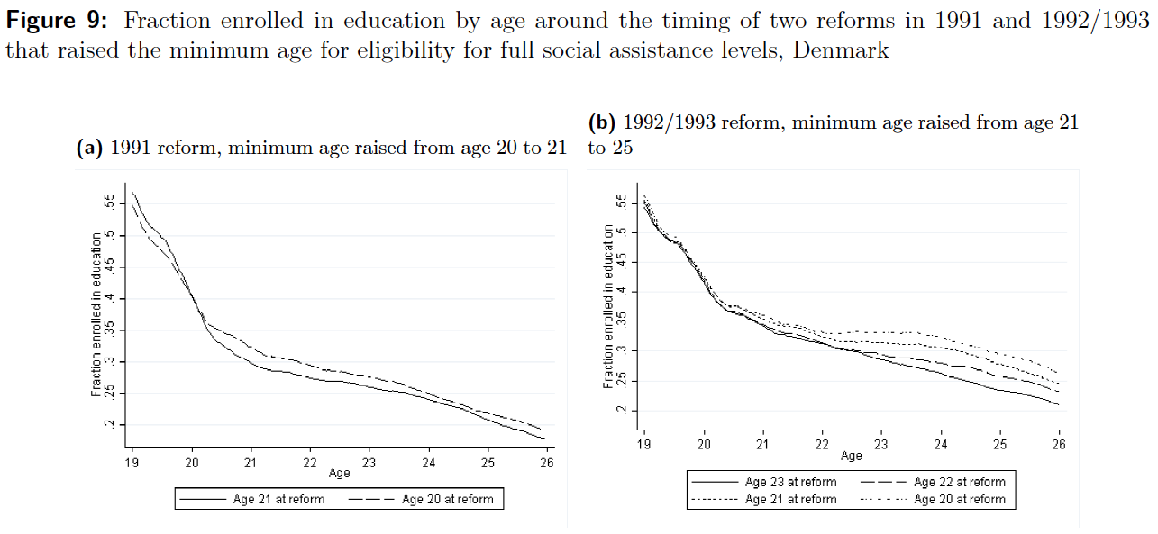

Slide 7
Returns to education
Hypothesis 1: Economic incentives are crucial
Policy impliction: Lower social assistance (for instance)

Slide 8
Information and misperceptions
Young people may lack information about the costs and benefits of education (– including the full benefits like health outcomes, happiness etc.)
ECO-C gave low-income high achievers information on applying to colleges, what they would actually pay at various colleges, colleges’ graduation rates and instructional resources, and no-paperwork fee waivers. Materials were customized to provide information specific to each student’s family circumstances and location. ECO-C did not recommend colleges but, rather, provided information that was relevant and in context. (Hoxby and Turner 2013; AER 2015)
(However, information may not be enough, Bettinger et al. QJE 2012)

Slide 10
Information and misperceptions
Hypothesis 2: Lack of knowledge/misperceptions of the total sum of returns to education is crucial
Policy implication: Inform young people about the costs and benefits

Slide 11
Social belonging
Experiments have shown that college students benefit when they understand that challenges in the transition to college are common and improvable and, thus, that early struggles need not portend a permanent lack of belonging or potential
Teaching a lay theory of social belonging before college matriculation increase enrollment and grade point average (Yeager et al. PNAS 2016)

Slide 12
Treatment
“When I first got to college, I worried that I was different from the other students. Everyone else seemed so certain it was the right place for them and were so happy here. But I wasn’t sure I fit in – if I would make friends, if people would respect me, if it was the right school for me. With time I came to realize that almost everyone comes to college and feels uncertain at first about whether they fit in. It’s just something everyone goes through. Now it seems ironic – everybody feels different first year, but really we’re all going through the same thing.”
+
write a brief essay about why it is common to initially feel unsure about whether they belong in college (…) and why these initial worries about belonging are likely to diminish over time as students come to feel at home in college.

Slide 13
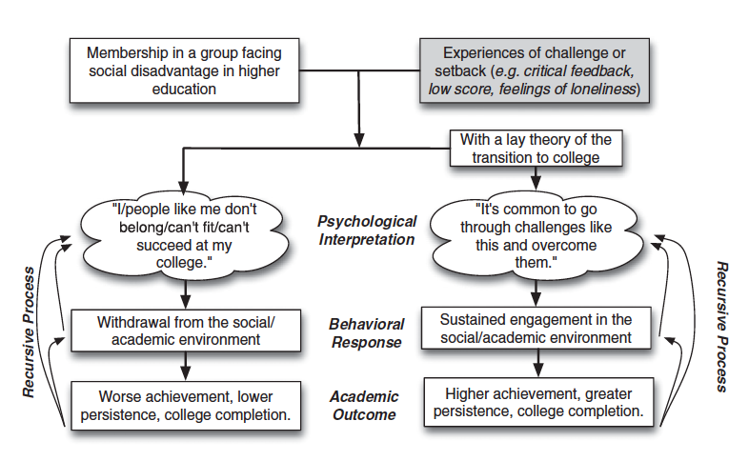

Slide 14
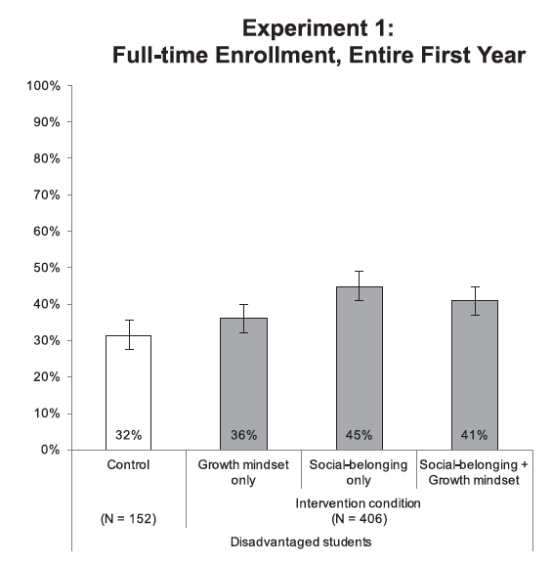

Slide 15
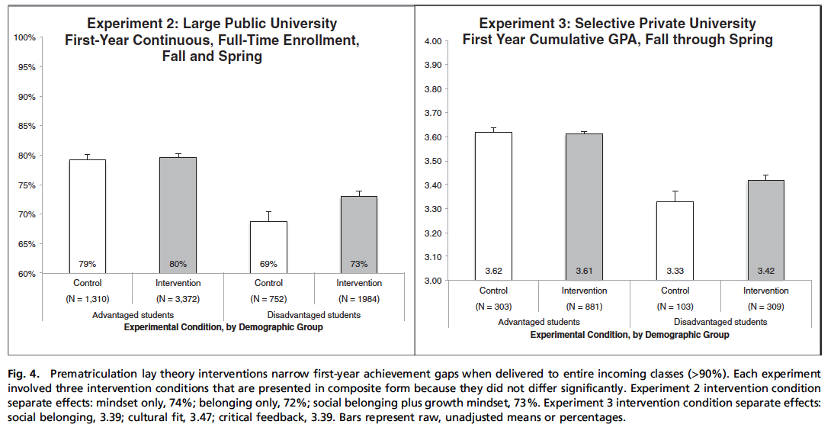

Slide 16
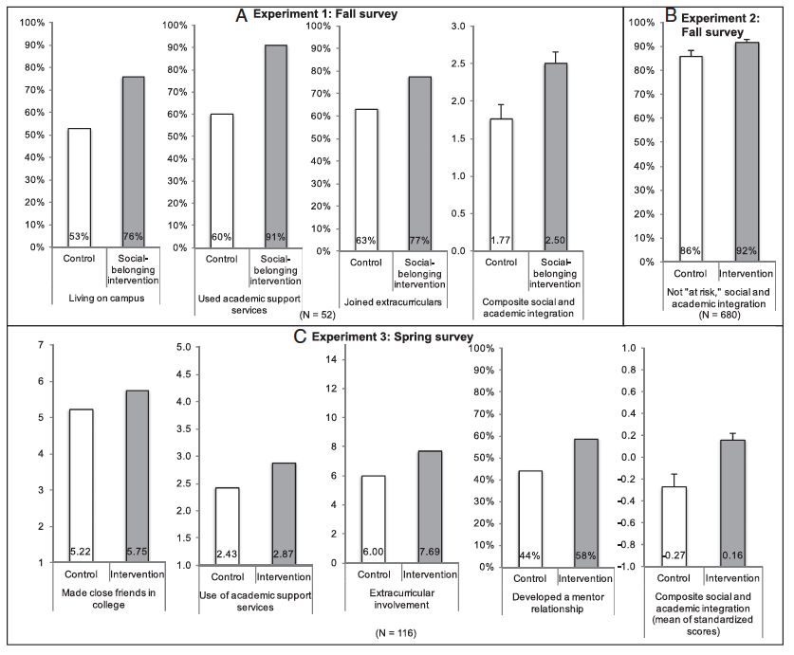

Slide 17
Social belonging
Hypothesis 3: The mindset about whether lack of social belonging is innate or something you can do something about yourself is crucial
Policy implication Teach social belonging mindset

Slide 18
Peer effects
Adolescents’ brains are highly sensitive to recognition from their peers. Sheer awareness of peers’ presence affect decisions and behavior (Steinberg 2014).
Complimentary access to an online SAT preparatory course. (Bursztyn & Jensen QJE 2015)
Treatment (as good as random): Sign-up in honors or non-honors classes and public vs. private decision

Slide 19
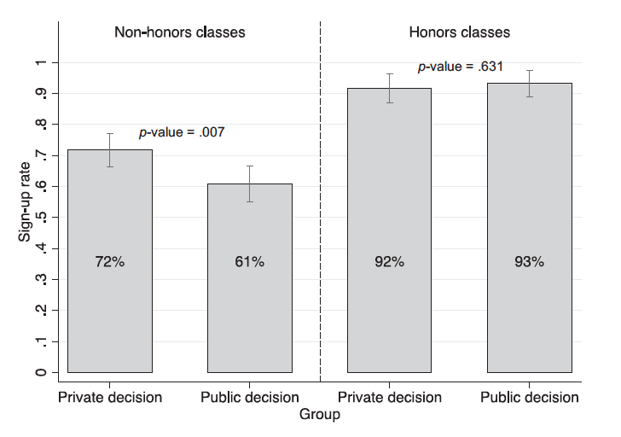

Slide 20
Research design
Data collection
Study 1: Pilot study (explorative). Survey to about 700 8th and 9th grade students in Vejen municipality
Study 2: Hypothesis testing. Survey to about 800 8th and 9th grade students in Aarhus municipality
Follow-up data on actual choice of education and drop-out

Slide 21
Experiment 1. information
Conjoint analysis to test how different information influence choice between two unnamed educations
 | Education 1 | Education 2
Life-time earnings | 13.7 mio. | 15.6 mio.
Life expectancy | 88 years | 76 years
Drop-out rates | 21 % | 21 %
Share of school mates choosing | 56% | 12%
…

Slide 22
Experiment 2. mindset intervention
Treatment as in Yeager et al. 2016:
“When I first got to college, I worried that I was different from the other students. Everyone else seemed so certain it was the right place for them and were so happy here. But I wasn’t sure I fit in – if I would make friends, if people would respect me, if it was the right school for me. With time I came to realize that almost everyone comes to college and feels uncertain at first about whether they fit in. It’s just something everyone goes through. Now it seems ironic – everybody feels different first year, but really we’re all going through the same thing.”
+
write a brief essay about why it is common to initially feel unsure about whether they belong in college (…) and why these initial worries about belonging are likely to diminish over time as students come to feel at home in college.

Slide 23
Experiment 3. peer influence
Experiment 3:
Emphasizing the presence of peers in the classroom will draw expectations in the direction of the peers’ expectations
Asking students to reflect on the relevant importance of peers for educational expectations will reduce the peer effect

Slide 24
Experiment 3. peer influence
 | Control | Peer attention
Control | Think about your school physical environment + explain about your thoughts about environment | How do your peers like vocational and general educational traingin? + explain about your thoughts about environment
De-emphasize | + How much should your peers’ educational choice affect your choice? | + How much should your peers’ educational choice affect your choice?
Outcome: Choose vocational or general educational training

Slide 26
The rational actor models
Human capital and the rates of return to schooling (Mincer 1958; Becker 1967; Ben-Porath 1967)
Discrete choice models (Rosen 1977; Willis & Rosen 1979; Keane et al 2011)
-> Choice of education is based on expectations about the outcome (especially lifetime earnings)

Slide 27
Expectations to public services
Predictive vs. normative expectations in public administration (James 2009; 2011)
Rational expectations is the cornerstone of expectations theory (Muth 1961; Cyert & DeGroot 1974; Lovell 1986)
Maximization of utility, takes all relevant information into account (Muth 1961)
Adaptive expectations (Nerlove 1958)
Averaging prior expectations and the most recent experience with the service
Similar to the “anchorig and adjustment” approach (Tversky & Kahneman 1974)
Motivated reasoning (Taber and Lodge 2006)
A “prior attitude effect”: Attitudinally congruent arguments are evaluated as stronger than attitudinally incongruent arguments

