Slide 1
Building a bridge to the educational system
- Quantitative results
Michael Rosholm & Michael Svarer
Dept. of Economics and Business Economics, and TrygFonden’s Centre for Child Research, Aarhus University
Notes:
Thanks to Helena Skyt Nielsen

Slide 2
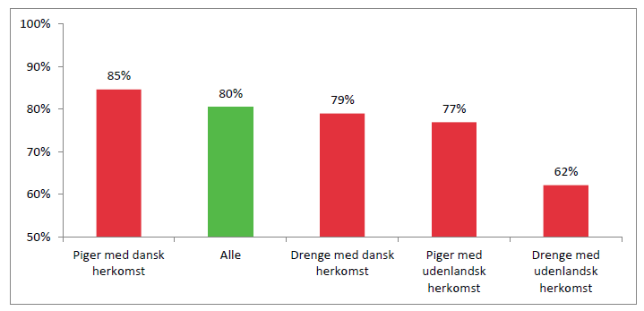
Fraction of a youth cohorde that has completed a youth education 7 years after leaving compulsory school, 2013
Source: Profil modellen, MBLIS, 2013

Slide 3
Intro & Background
Some of these young persons have temporary unskilled jobs
They have several attempts at high school or vocational education, but drop out rates are large

Slide 4
Intro & Background
Why did you drop out of your past education?
Source: Görlich, Katznelson, Hansen, Rosholm & Svarer (2015)

Slide 5
Intro & Background
Some of these young persons have temporary unskilled jobs
They have several attempts at high school or vocational eucation, but dropout rates are large
…so many end up on welfare for shorter or longer periods – a bridge of failures
These young persons are the targeted group for the intervention ‘building a bridge to the educational system’

Slide 6
Intro & Background
The aim of the intervention:
To help those in the target group into the ordinary educationals system and keep them tere

Slide 7
Intro & Background
Two interventions aimed at this group have been tested recently
A mentoring intervention (evaluated in an RCT)
Natural comparison
Building a bridge to the educational system (evaluated using PSM)

Slide 8
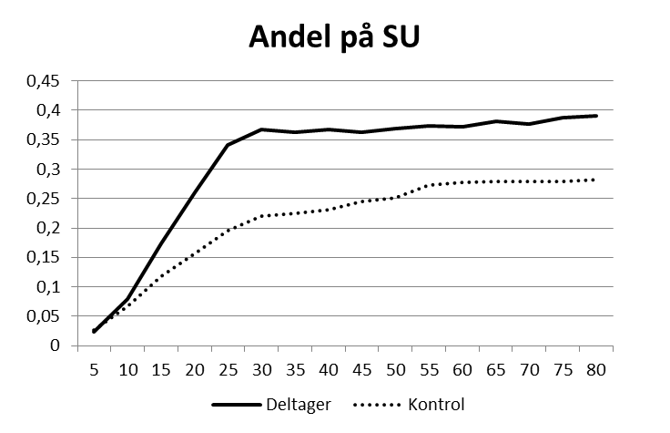
Brobygning til uddannelse - effekterne

Slide 9
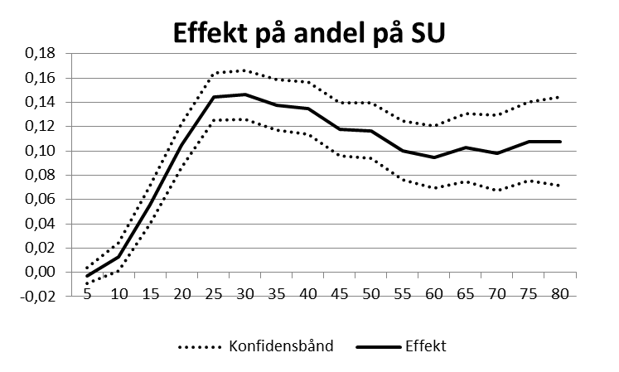
Brobygning til uddannelse - effekterne

Slide 10
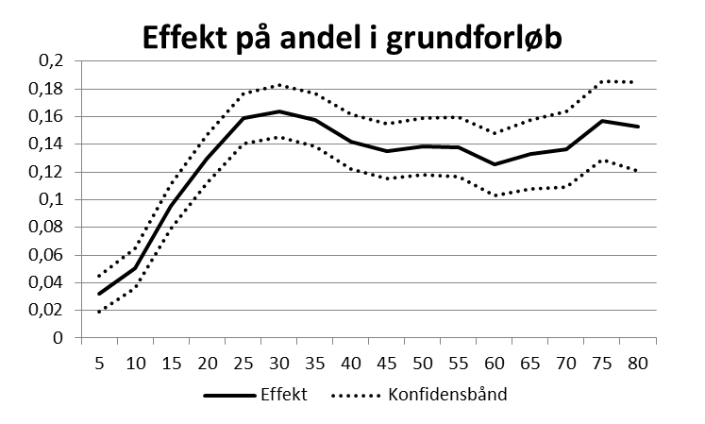
Brobygning til uddannelse - effekterne

Slide 11
Building a bridge - impacts
Positive effects for vocational basic, vocational main, and lower secondary (compulsory)
Effects found at 10 out of 12 participating vocational training sites
Positive effects for the more disadvantaged youth;
Those without compulsory school leaving exams, men, long time on public income support

Slide 12
Costs & comparison
Average costs per participant
Mentor $3550
Building bridges… $4900
Effect per $1000 per participant
Mentor (4%) 1.14%-points
Building bridges (14%) 2.86%-points
(…fairly large impacts in int’l comparison – e.g. Cook et al., 2014)

Slide 13
Conclusion
‘Building bridges…’ bridges the gap from welfare to education!
…and the impact is (at least) decent sized
It works particularly well for weaker groups – probably due to scaffolding nature of the inrtervention?
Makes sense to try to adapt it to targeting an even weaker group of individuals

