Slide 1
Intensive learning camps
KAMILLA T GUMEDE
TrygFonden’s Center for Child Research
28th of September 2016

Slide 2
Can a 2-weeks intensive learning camp help disadvantaged 8th graders catch up academically and become ready for post-compulsary education?
Michael Rosholm, Kamilla Gumede, Julia Nafziger, Alexander Kochs.
In collaboration with VIA, METROPOL & Rambøll Management Consulting

Slide 3
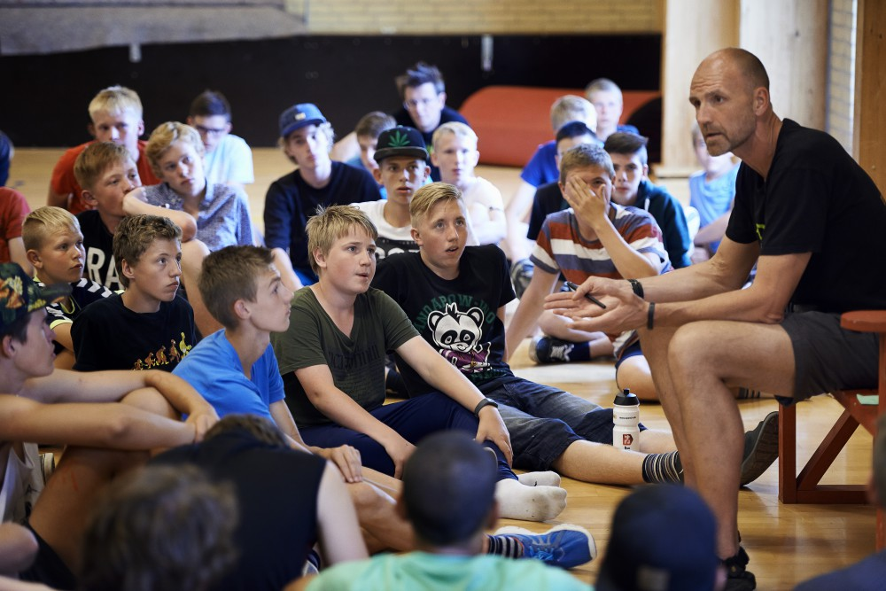

Slide 4
Intensive learning camps are popular
DR TV-series on DrengeAkademiet – Tro på det!
52% of Danish municipalities run or send pupils on intensive learning camps (Epinion, 2016)
Common features:
  1-4 weeks training
  Camp
  Focus on academic skills, personal development
90% of schools make use of intensive learning / emneuger (Egmont report, 2015)

Slide 5
Previous evaluations

Slide 6
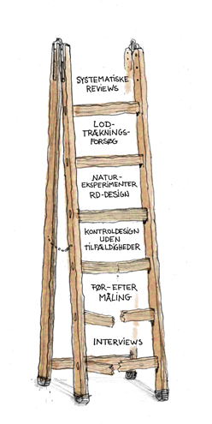
Questions, not yet answered
Ministry of Education / Ministeriet for Børn, Undervisning og Ligestilling
DKK 20.8 million, 2016 – 2019
Impact evaluation at the top of the evidence ladder
  Selection bias
  Effects over time
Comparing apples-to-apples:
  Eg. young, low academic performance – and motivated?

Slide 7
Randomised impact evaluation
Target population
flip a coin
a -- 50% schools run camp in 2017
b -- 50% schools provide existing learning opportunities
Impact = difference in average a – average b, over time

Slide 8
Randomised impact evaluation
Target population:
8 graders not ready for post-compulsary education
Camp 1
Camp 2
Treatment as usual
Low-cost nudge
Mentors
Need a total of 132 schools!

Slide 9
The camps
- Camp 1: Equip pupils with henced learning techniques and habits
- Camp 2: Strengthen personal and social skills
2-weeks camp, 37 hours a week
Maths, Danish, social and personal skills
Tailored to the individual pupils’ level, visible learning
High expectations

Slide 10
Not (quite) like other camps
The program is implemented at schools, not camps
Pupil - teacher ratio of max. 5:1
Budget of DKK 5,000 pr. pupil
”Average teacher” trained for 1½ days
Not only the most motivated pupils
No evening program - they eat and sleep at home
No direct controls against absenteeism

Slide 11
The young adults
Grade 8 pupils not ready to enter vocational training or high school
30% of all grade 8 pupils, or 15,000 every year
  62% boys
  38% girls
Voluntary, but aimed at everyone

Slide 13
School absenteeism

Slide 14
Danish test scores

Slide 15
Many academically disadvantaged pupils in grade 8
felt behind much earlier !

Slide 16
On the shoulders of solid knowledge
Hatties visible learning
Grit and ”deep practice” lessons (Duckworth et al., forthcoming)
Correcting hyperbolic discounting (Alan and Ertac, forthcoming)
Mindsets (Miu &Yeager, 2015, Yeager et al., 2016)
Meta cognitive study habits (Donker, 2013)
Practical experiences from existing Danish camps

Slide 17
Skills, that pupils lack

Slide 18
Outcome measures
Data collection
Ready for post-compulsary education | Evaluated by UU-counselors grade 9, 10
Danish and math proficiency | Grades by teachers - grade 8, 9, 10
School absenteeism | Grade 9, 10
Wellbeing | National survey, grade 9, 10
Social and personal skills | Questionnaire, grade 9 (UU-counceling)
Education choice, take-up | Registry data
Longterm effects on education, income, wellbeing | Registry data
Fidelity | Rambøll
Case studies | Rambøll

Slide 19
Timeline
2016 – 2017
AUG | Curriculum development
SEP | Pilot testing, recruitment
OCT – DEC | Finalisation
JAN | Teacher workshop
FEB - APR | Implementation of round 1 (of 3)
2016
2017
2018
2019

Slide 20
THANK YOU

